Slide 1
Algorithms for speech and language processing
Challenges and perspectives

Slide 2
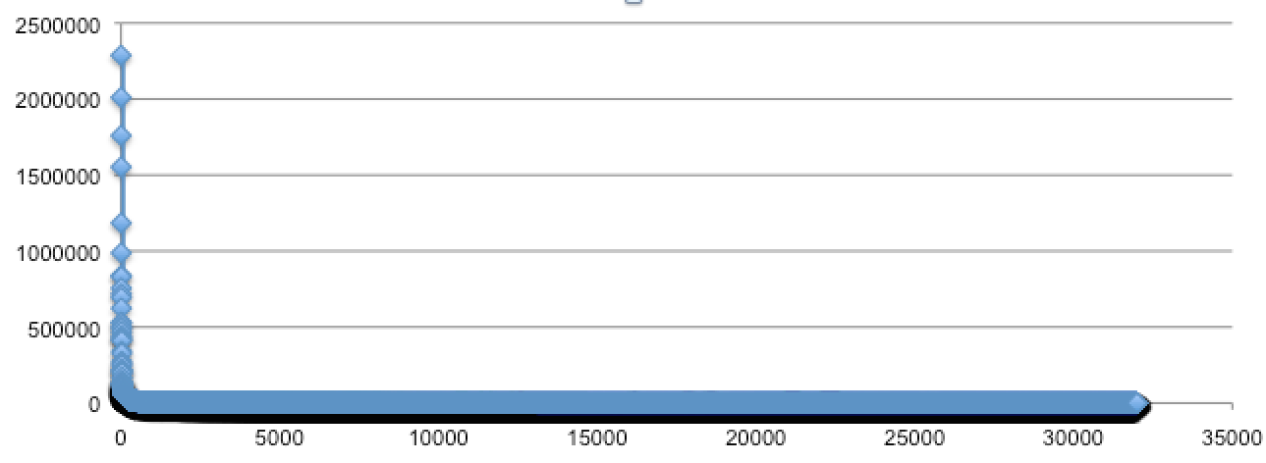
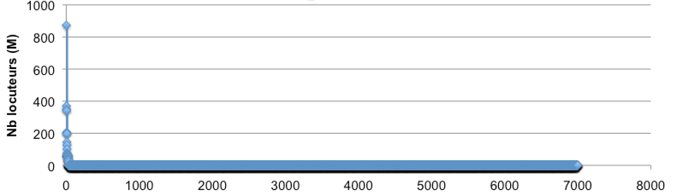
Power law, everywhere
sounds
words
sentences
languages

Slide 3
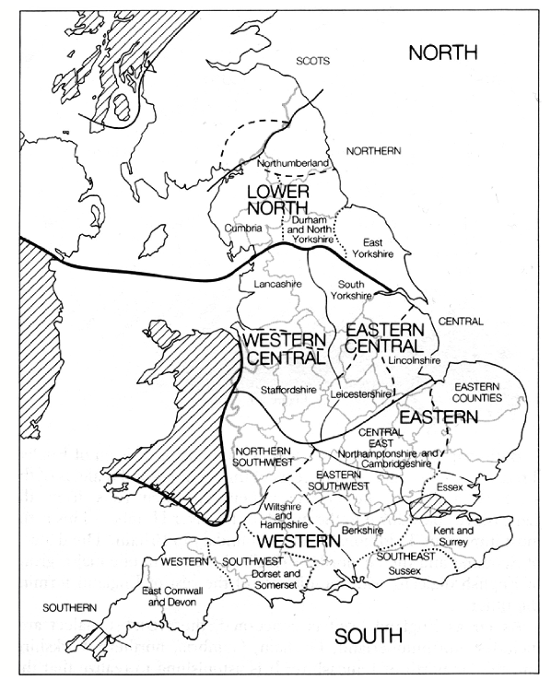
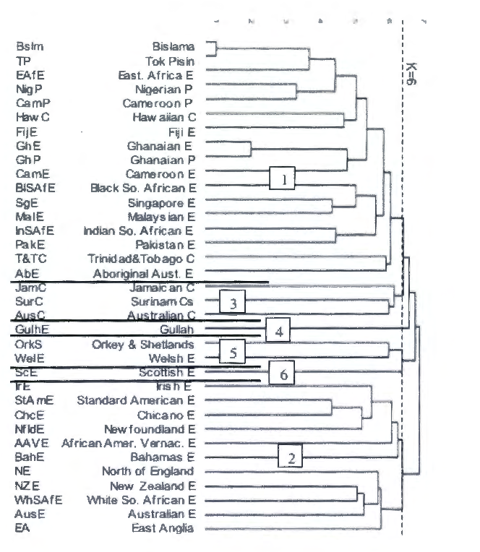
Sounds: dialects, registers, etc
Google Speech API
13 versions of English
English (Australia) en-AU
English (Canada) en-CA
English (Ghana) en-GH
English (Great Britain) en-GB
English (India) en-IN
English (Ireland) en-IE
English (Kenya) en-KE
English (New Zealand) en-NZ
English (Nigeria) en-NG
English (Philippines) en-PH
English (South Africa) en-ZA
English (Tanzania) en-TZ
English (United States) en-US
20 versions of Spanish
etc
Trudgill 1999
Nagy et al, 2006

Slide 4
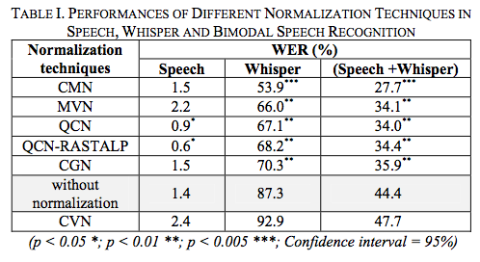
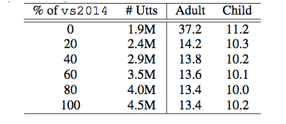
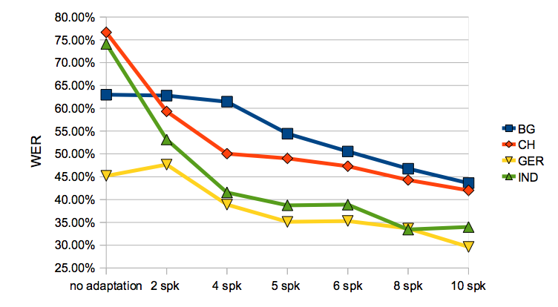
Sounds: dialects, registers, etc
children’s voice
whispered speech
Youtube Kids,
Liao, Pundak et al 2015
foreign accented speech
Grozdic, Jovicic et al. (2017)
Mihaylova, (2011)

Slide 5
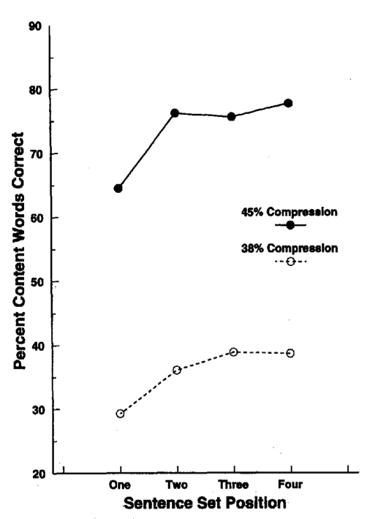
perceptual adaptation in humans
fast dialect adaptation (Maye, Aslin, Tanenhaus, 2008)
the wicked witch of the west -> the weckup wetch of the wast
20 minutes exposition
lexical decision: ‘wetch’ -> 69% word
compressed speech (Dupoux & Green 1997)
4 sets of 5 sentences

Slide 6
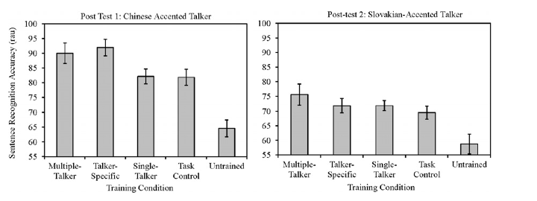
accented speech (Bradlow & Bent 2008)
training: 5 repetitions of 16 sentences (in noise, no feedback)
test: 2 new sets of 16 sentences

Slide 7
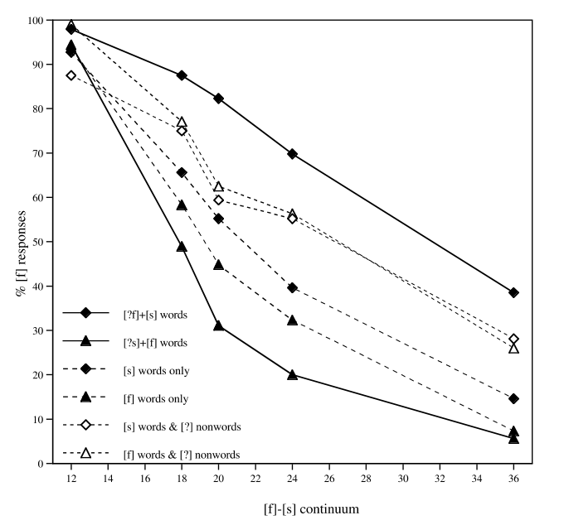
perceptual learning (Norris, McQueen Cutler, 2003)
20 words with ambiguous final s/f
(eg: astu[sf]e, or cara[sf]e)

Slide 8
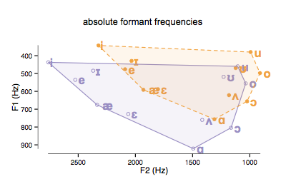
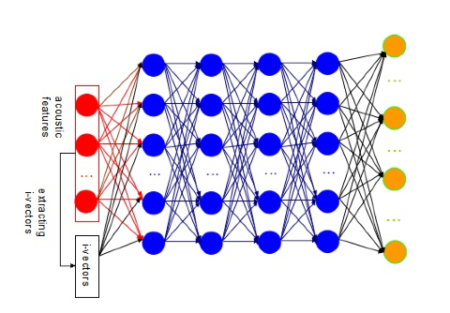
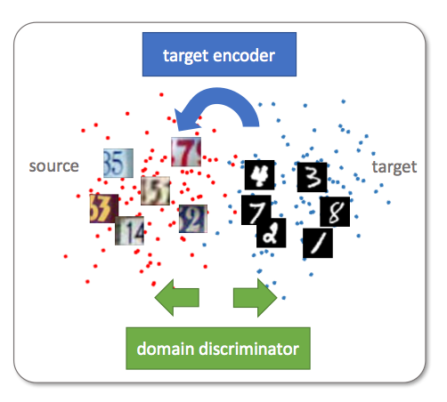
domain adaptation in machines
fMLLR
x←Ax+b to maximize p(x|speaker)
i-vectors
adversarial domain adaptation
Chen, Liang et al (2015)
Tzeng, et al 2017

Slide 9
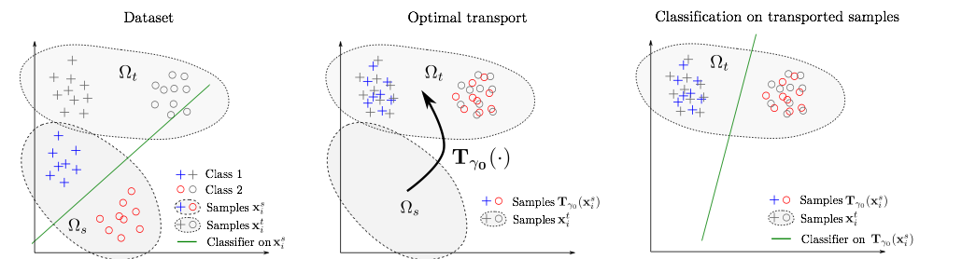
optimal transport
Courty et al (2016)
Voir survey (vision) Csurka (2017)

Slide 10
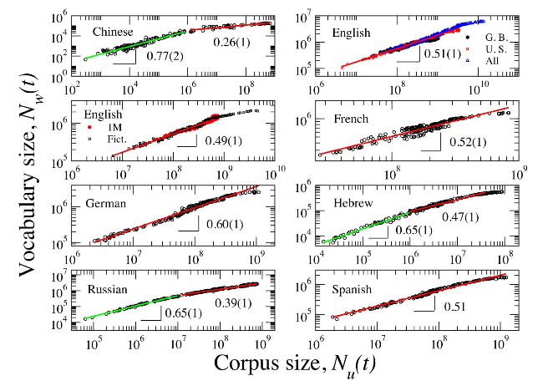
Words: the problem of oovs
pocket French 50Mw
Heaps law
Petersen et al (2012)

Slide 11
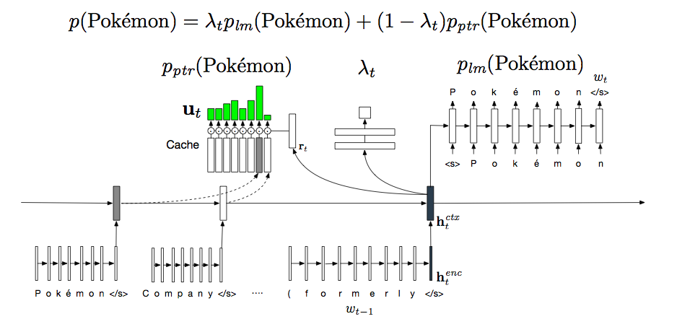
possible solution: episodic memory
a cache based model of speech recognition Kuhn & de Mori (1990)
Hybrid LSTM-Cache systems
Kawakami, Dyer, Blunsom (2017)
Grave Cisse Joulin (2017)

Slide 12
sentences: the problem of systematicity
r
→ RNN trained to predict the next character
SCÈNE III.--ALCANTOR, BASQUE, MARIANE, DU CROISY, BESTARIN, LE BARBOUILLÉ, MASCARILLE.
MASCARILLE.
Je ne puis davantage à propos.
MARIANE.
o ciel! de tout ce qu'il doit faire, et sa gloire à tous deux,
Qui sait se montrer des vœux de notre ressentiment:
Si bien de suivre le plus grand embarras?
Mais on puisse ravir à vous payer de vous faire l'ardeur.
ÉRASTE.
Je ne sais.
B o n j o u
Trained on Molière’s work
Karpathy (2015). The Unreasonable Effectiveness of Recurrent Neural Networks http://karpathy.github.io/2015/05/21/rnn-effectiveness/

Slide 13
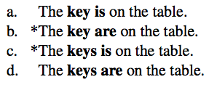
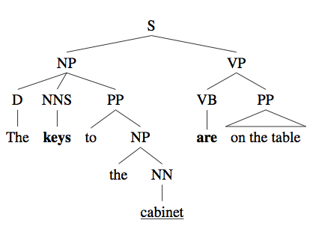
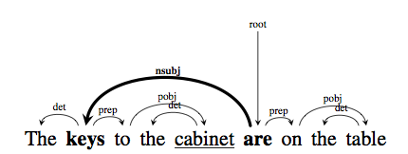
infants acquire number agreement (in comprehension) at 18 months (Xi et al, in prep)
Materials:
1.3M sentences from 2013 Wikipedia dump
less than 50words
singular or plural noun subject
least one subject-verb dependency
system: word level RNN/LSTM
Linzen, Dupoux, & Goldberg, (2016).

Slide 14
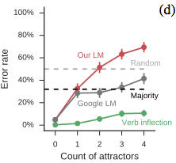
Training a language model
testing on number agreement
error rate: < 5%
Linzen, Dupoux, & Goldberg, (2016).

Slide 15
Training a language model
testing on number agreement
error rate: < 5%
0 1 2 3 4
Linzen, Dupoux, & Goldberg, (2016).

Slide 16

compositionality
He daxed.
He daxed twice.
He daxed again and ran.

Slide 17
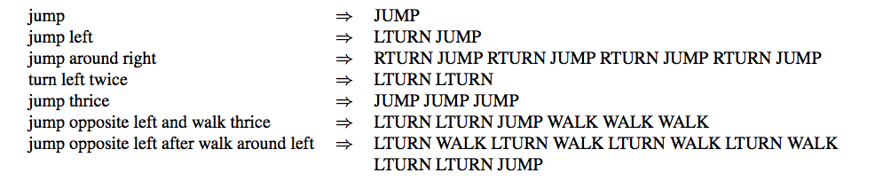
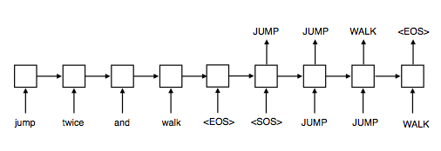
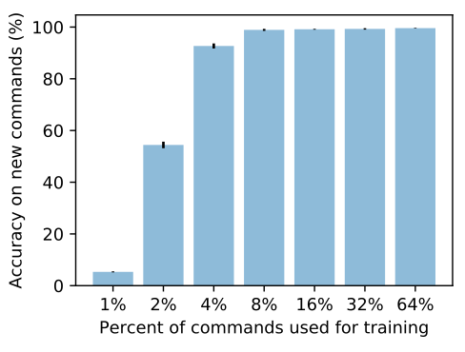
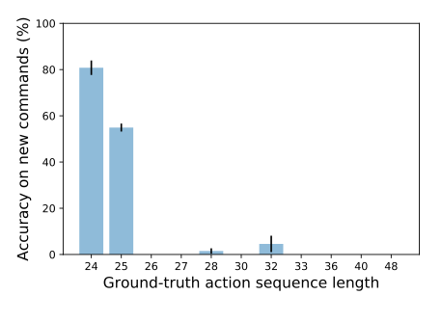
Best architecture
2 layers LSTM, 200 hidden
train: random subset
results as a function of action sequence length
Lake & Baroni (2017)

Slide 18
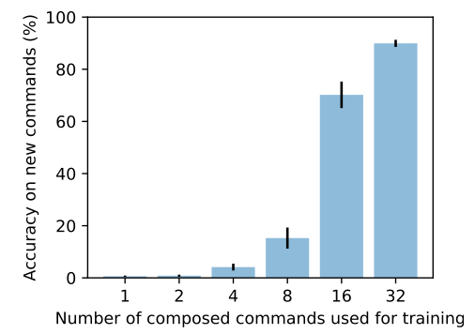
train with
composed actions: (run, walk, look )+ (twice, thrice, left, and V, etc)
uncomposed novel action: jump
test with
novel combinations of composed actions: 90% correct
combination of basic action: 0.08%-1.2% correct
Same problem in translation
the machine needs a lot of evidence that the novel action can be composed to generalize
Lake & Baroni (2017)

Slide 19
The Fodor & Pylyshyn (1990) argument
mental representations have a constituent structure
they are not atomic or hollistic but have parts with specific roles
eg: the red cow; cheese or desert, Vx R(x), A->B
Some constituents can be recursive
eg: P. thinks that « M. is nice » -> J thinks that « P thinks that « M is nice » »
mental processes are structure sensitive
eg: combinatorial semantics
semantics of « J. loves M. » derived from semantics of « J. », « loves » and « M. »
eg: logical inferences:
A->B, A entails B ; this does not depend on the meaning of A and B but on the structure of the representations
as a result, mental computations are
systematic
all humans are mortal -> John is moral, Mary is mortal, etc.
« Paul likes fruits » grammatical -> « Paul likes fruits » also grammatical, etc
productive (achieve discrete infinity)
the list of thoughts/sentences is not finite (I can construct new thoughts with old ones)
connectionist representations have none of these properties

Slide 20
possible solutions
symbols and rule systems
hand-written rules
non parametric Bayesian
tensor products (Smolensky, 1990)

Slide 21
The Smolensky response: filler/roles & tensor products
The problem: representing tree structures
S
S
Subj
Obj
Subj
Obj
Vb
Vb
Paul loves Mary
{Subj=Paul, Vb=loves, Obj=Mary}
Mary loves Paul
{Subj=Mary, Vb=loves, Obj=Paul}
The recipe:
1. define fillers and roles
2. combine them into a representation with two basic operations: binding (=), superposition (,)
Note: the order of the components does not matter
{Subj=Paul, Vb=loves, Obj=Mary} = {Obj=Mary, Subj=Paul, Vb=loves}
!= {Obj=Paul, Subj=Mary, Vb=loves}
Smolensky, P. (1990). Tensor product variable binding and the representation of symbolic structure in connectionnist systems. Artificial Intelligence, 46, 159-216.

Slide 22
The Smolensky response: filler/roles & tensor products
S
The problem: representing tree structures with numbers
Subj
Obj
Vb
Binding: tensor product
Superposition: addition
Paul loves Mary
{Subj=Paul, Vb=loves, Obj=Mary}
Subj=Paul
Vb=loves
Obj=Mary
Subj
Subj
Subj
Vb
+
Vb
+
Vb
Obj
Obj
Obj
Paul
Mary
Jane
loves
Paul
Mary
Jane
loves
Paul
Mary
Jane
loves
{Subj=Paul, Vb=loves, Obj=Mary}
Subj
=
Vb
Obj
Paul
Mary
Jane
loves

Slide 23
The Smolensky response: filler/roles & tensor products
The problem: representing tree structures with numbers
S
S
Subj
Obj
Subj
Obj
Vb
Vb
Paul loves Mary
Mary loves Paul
{Subj=Paul, Vb=loves, Obj=Mary}
{Subj=Mary, Vb=loves, Obj=Paul}
Subj
Subj
Vb
Vb
Obj
Obj
Paul
Mary
Jane
loves
Paul
Mary
Jane
loves

Slide 24
The Smolensky response: filler/roles & tensor products
The problem: representing tree structures with numbers
Distributed representations for fillers
S
S
Subj
Obj
Subj
Obj
Vb
Vb
Paul loves Mary
Mary loves Paul
Paul
Mary
loves
{Subj=Paul, Vb=loves, Obj=Mary}
{Subj=Mary, Vb=loves, Obj=Paul}
Subj
Subj
Vb
Vb
Obj
Obj

Slide 25
The Smolensky response: filler/roles & tensor products
The problem: representing tree structures with numbers
Distributed representations for fillers & roles
S
S
Subj
Obj
Subj
Obj
Vb
Vb
Paul loves Mary
Mary loves Paul
Subj
Vb
Obj
Paul
Mary
loves
{Subj=Paul, Vb=loves, Obj=Mary}
{Subj=Mary, Vb=loves, Obj=Paul}

Slide 26
The Smolensky response: filler/roles & tensor products
The problem: representing recursive tree structures with numbers
S
Subj
Obj
{0_Subj=Paul, 0_Vb=loves, Obj_Subj=Mary,
Obj_Vb=loves, Obj_Obj=Jane}
Vb
Paul thinks
S
Subj
Vb
Obj
Mary loves Jane
Obj
Subj
0
Subj
Vb
Obj
Paul
Mary
Jane
thinks
loves
Smolensky, P. (1990). Tensor product variable binding and the representation of symbolic structure in connectionnist systems. Artificial Intelligence, 46, 159-216.

Slide 27
The Smolensky response: filler/roles & tensor products
The problem: manipulating recursive tree structures with numbers
S
Subj
Obj
Pred
Arg1
Arg2
Vb
Paul thinks
S
Subj
Obj
Pred
Arg1
Vb
Mary loves Jane
Thinks(Paul,Loves(Mary,Jane))
Obj
Arg2
Subj
Arg1
0
0
Subj
Pred
Vb
Arg1
Linear transformation
Obj
Arg2
Paul
Mary
Jane
thinks
loves
Paul
Mary
Jane
thinks
loves
Smolensky, P. (1990). Tensor product variable binding and the representation of symbolic structure in connectionnist systems. Artificial Intelligence, 46, 159-216.

Slide 28
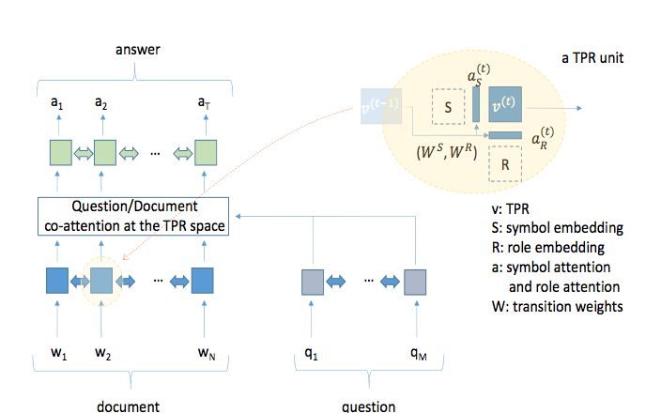
Tensor Product Recurrent Network
Palangi, Smolensky, He, Deng, 2017

Slide 29
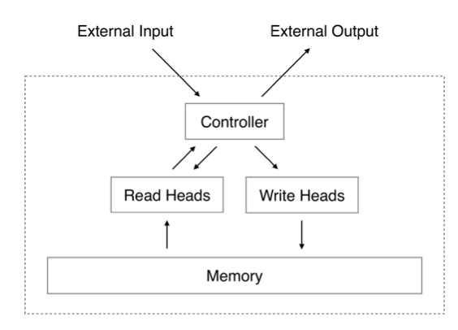
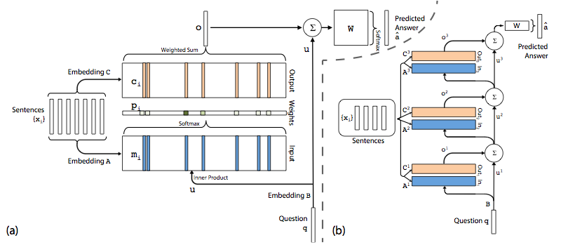
possible solutions
symbols and rule systems
hand-written rules
non parametric Bayesian
tensor products
memory networks?
Graves, A., Wayne, G., & Danihelka (2014)
Weston Chopra & Bordes (2015)

Slide 30
Languages: Paying the price of big data
Google stops here (1%)
the long tail
50% of languages have no usable orthography
Moroccan Arabic (21M), Nigerian languages: Igbo (25M)
Even in English:
non standard channels (novel background noise)
non standard articulation (children, seniors, etc)
non standard pronounciation (sociolects, idiolects, foreing accent)
non standard language models (casual versus formal speech)
→ but infants can learn languages without any orthographic input!

Slide 31
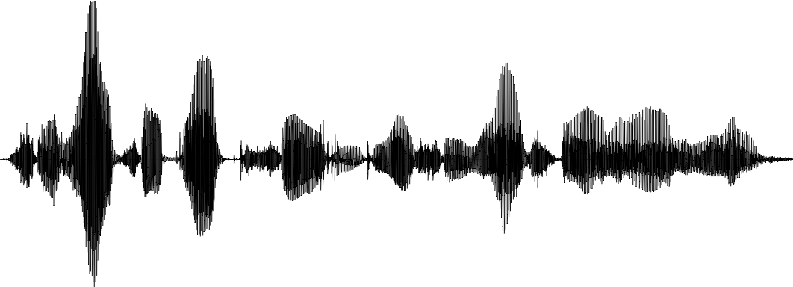
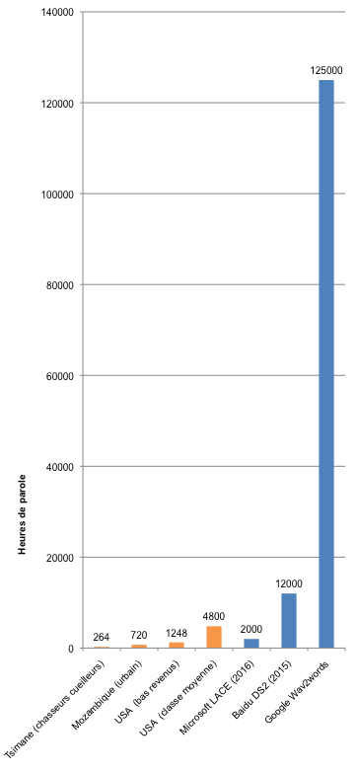
The data efficiency problem
125000
End-to-end ASR
« She had your dark suit in greasy wash
water all year »
cost function
labels
(evaluation & training)
human
expert
optimization algorithm

Slide 32
The data efficiency problem
125000
End-to-end ASR
+ 1000000000 words of text for language modeling!
(10000 books)
« She had your dark suit in greasy wash
water all year »
cost function
labels
(evaluation & training)
human
expert
optimization algorithm

Slide 33
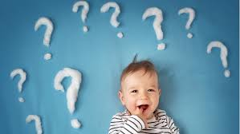
How much data?
125000

Slide 34
Language acquisition trajectories
Semantics
frequent words
Segmentation
of words from
sentences
Word forms
Proper name
Perception
Language prosody
Typical word stress
Prosody
Segmentation
in large
clauses
Segmentation
in small
clauses
Phonotactic
illusions
Segments
Typical vowels
Phonotactics
Loss of non-native
contrasts
Typical consonants
Time (months)
0 1 2 3 4 5 6 7 8 9 10 11 12 13 14
Production
vowel-like
Language
-specific
sounds
‘words’
canonical
babbling

Slide 35
How much data?
125000
Supervised (orthographically transcribed)
Unsupervised (sensory data only)
USA (high SES)
Mozambique
Tsimane
USA (low SES)
Cristia et al, in press
4 year olds

Slide 36
How much data?
125000
+ 1000000000 words of text
+0 words of text!
Supervised (orthographically transcribed)
Unsupervised (sensory data only)
USA (high SES)
Mozambique
Tsimane
USA (low SES)
Cristia et al, in press
4 year olds

Slide 37
How much data?
125000
+ 1000000000 words of text
+0 words of text!
+multimodal input
+some parental feedback
Supervised (orthographically transcribed)
Unsupervised (sensory data only)
USA (high SES)
Mozambique
Tsimane
USA (low SES)
Cristia et al, in press
4 year olds

Slide 38
Developmental Artificial Intelligence
language learning=learning a compact representation for the input (Kelley, 1967, de Marcken, 1996)
language learning=learning to translate between surface input to underlying concepts (Siklossy, 1968; Siskind, 1996)
language learning=learning to communicate (Bruner 1975)

Slide 39
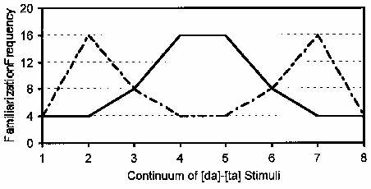
In infants
Artificial language learning
phonetic learning (Maye, Werker & Gerken, 2002)
word segmentation (Saffran et al. 1996)
‘algebraic’ rule learning (Marcus, et al., 1999)
gakotibunitagakotiralépy
ABB vs ABC

Slide 40
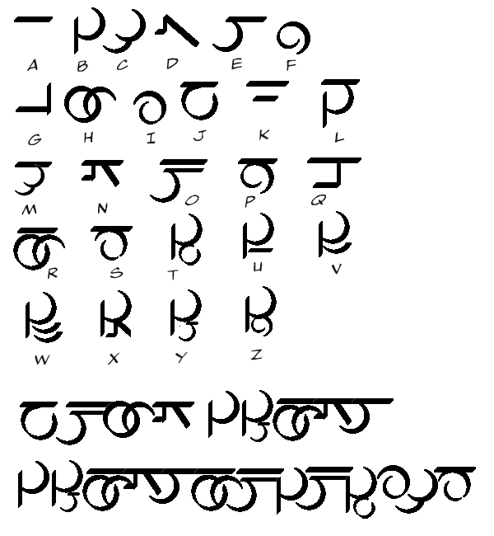
The zero resource challenge(s)
In an unknown language, from raw speech discover:
invariant subword units (Track 1)
words/terms (Track 2)
ZR15 (Interspeech 2015)
English (casual, 12 speakers, 5 hours)
Xitsonga (read, 24 speakers, 2.5 hours)
ZR17 (ASRU 2017)
3 dev languages: English, French Mandarin (12-69 speakers, 2.5-45h)
2 surprise languages: German, Wolof (24-30 spakers, 10-25h)
Aalto University, Finland
KTH, Sweden
University of Edinburgh, UK
U. Tilburg, Netherlands
Ecole Normale Sup, France
Instituto Italiano di Tecnologia, Italy
IIT Hyderabad, India
Stellenbosch, U. South Africa
National Taiwan U., Taiwan
A*STAR, Singapore
NAIST, Japan
Carnegie Mellon, USA
U. Chicago, USA
Stanford Univ, USA
Johns Hopkins, USA
MIT, USA
…
+ support from MSR, Google
www.zeropeech.com

Slide 41
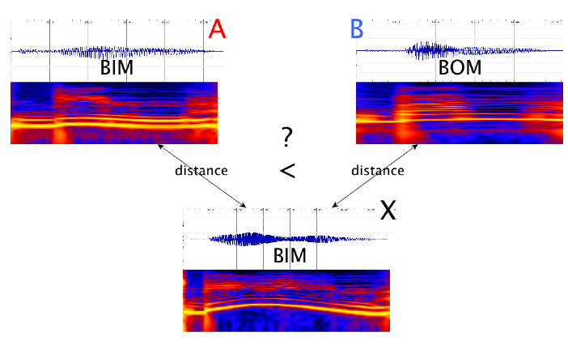
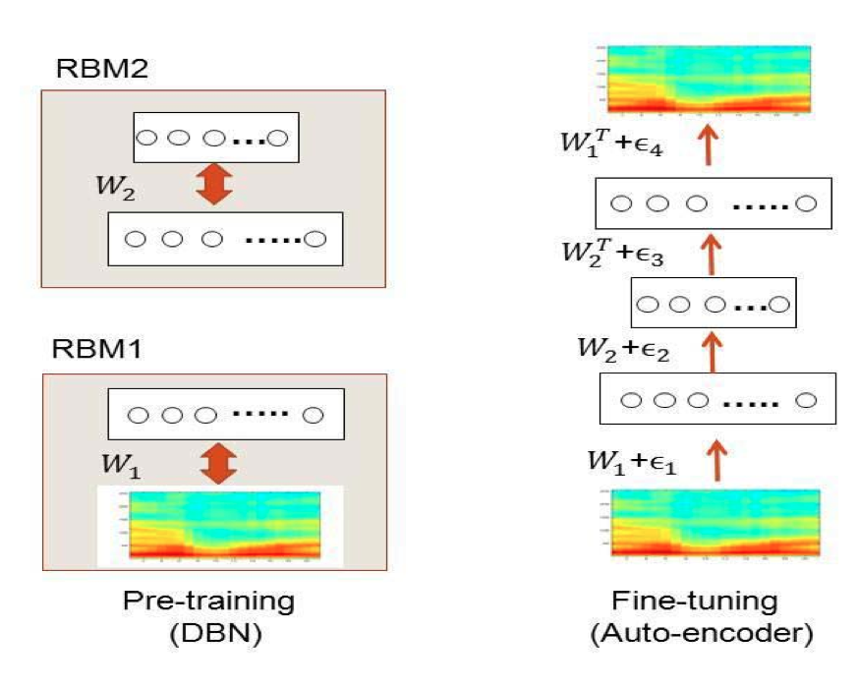
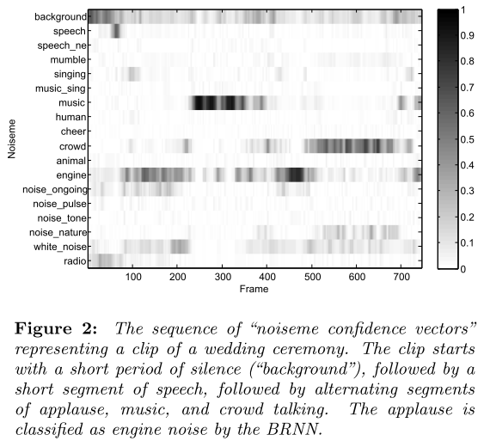
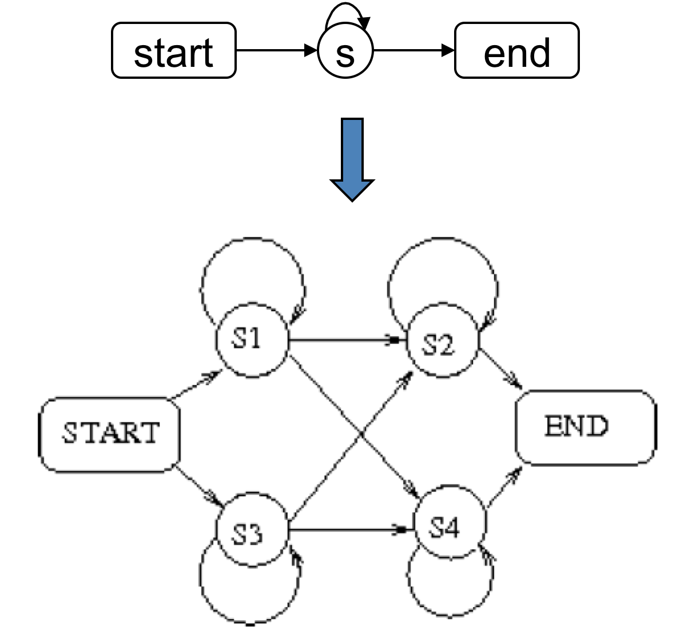
Track 1. ideas
Evaluation: psychophysical ABX task
A B X
ba_{T1} ga_{T1} ga_{T2}
low dimension continuous representations
Autoencoders (e.g. Badino et al. 2015)
probabilistic codes
posteriors of unsupervised GMMs (e.g. Heck et al 2015)
discrete codes
Unsupervised clustering, binarized DNNs (e.g. Myriam & Salvi 2017)
Main idea: information compression
spectral information: 20800bit/sec,
phoneme information: ~100bits/sec
→ a 200x reduction !

Slide 42
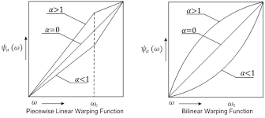
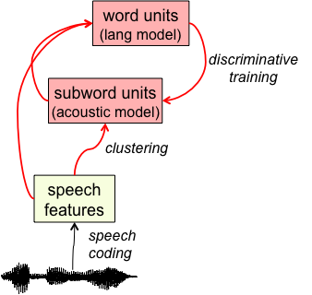
Track 1: more ideas
Talker Normalization
remove linguistically irrelevant information (talker identity, channel, emotional states, etc).
method:
features level normalization: VTLN (Chen et al. 2015)
model level normalization: fMMLR, etc (Heck et al 2016; 2017)
Using Track 2 to help Track 1
principle: minimal pairs are rare
same words → 100% phonemes same
different words → 90% phonemes are different
method: top-down signal
Correspondance AE (Kamper et al 2015)
Siamese network (Synnaeve et al., 2014)

Slide 43
Track 1: Leaderboard
[Eng, Xit]
Paper | Compression | Normalization | Contrast | Articulation | Result (%supervized)
Chen et al. 2015 | DPGMM | VTLN |  |  | [95%, 56%]
Heck et al. 2016 | DPGMM | VTLN+LDA |  |  | [100%, 72%]
Renshaw et al. 2015 |  |  | Corr AE |  | [58%, 49%]
Thiollière et al. 2015 |  |  | Siamese |  | [84%-58%]
Heck et al 2017 | DPGMM | VTLN+LDA+MLLT++fMMLR |  |  | [109%, 74%]
ZR15
ZR17
[Ger, Wol]
Attention: these are NOT phonemes!

Slide 44
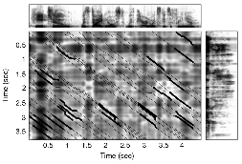
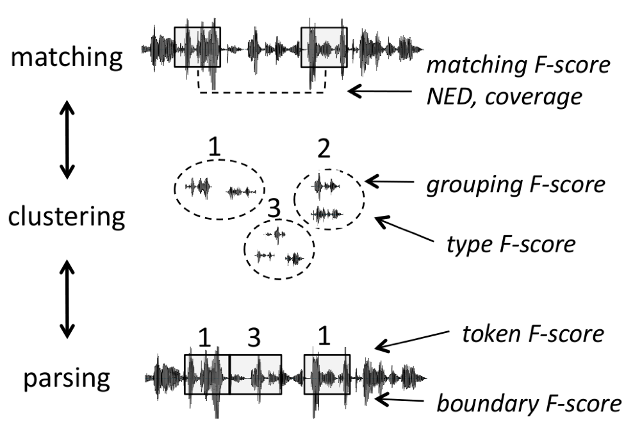
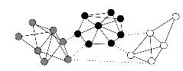
Track 2
task
Finding repeated patterns
Clustering these patterns
Using known words to find new ones
(Viterbi decoding)
Algorithms: Park & Glass, (2008), Jansen et al. (2010), Muscariallo et al (2011)

Slide 45
Track 2: evaluations
task
compare with ‘gold’ words
(Viterbi decoding)
compare with ‘gold’ boundaries
Algorithms: Park & Glass, (2008), Jansen et al. (2010), Muscariallo et al (2011)

Slide 46
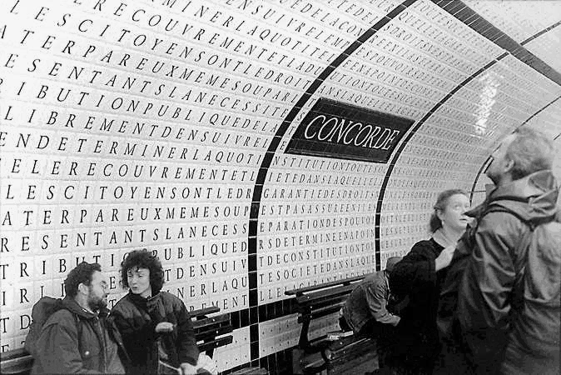
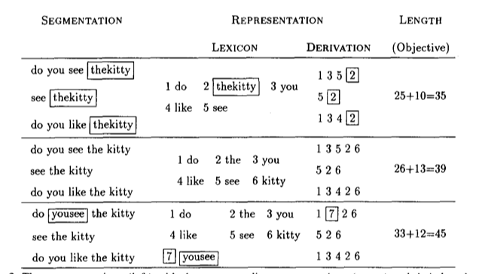
the case of text
Minimal description length
minimize the size of the lexicon plus
corpus description (Brent & Cartwright,1996)
Non Parametric Bayesian (Chinese Restaurant process)
maximize the probability that the corpus is generated by a lexicon (Goldwater, 2007; Johnson, Griffith Goldwater, 2007)

Slide 47
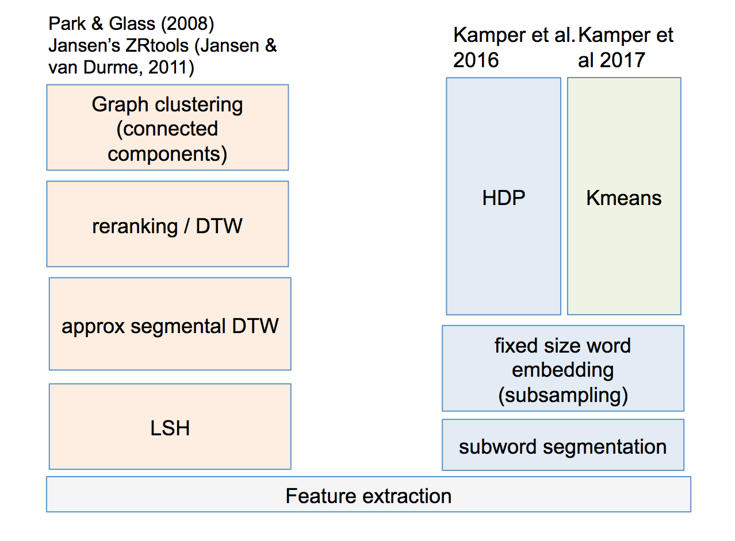

Slide 48
Track 2: leaderboard
[Eng, Xit]
Paper | Method | Result (Boundaries) (%supervized) | Results (Type) (%supervized)
Rasanen et al. 2015 | SyllOsc | [48%, 36%] | [21.1%, 9%]
Lizinski et al. 2015 | FDPLS-DTW+ConnComp | [36%, 40%] | [3.4%, 40%]
Kamper et al. 2016 | Word embeddings+ DPGMM | [68%, 50%] | [30%, 24%]
Garcia-Granada et all. 2017 | Out of domain ASR + DTW | [30%,32%] | [13%,15%]
Kamper et al. 2017 | Word embedding + kmeans | [58%,49%] | [24%,14%]
ZR15
ZR17
[Ger, Wol]
→ Still long way to go for word discovery

Slide 49
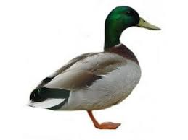


Where to go next? (I)
topic models
(lang model)
distributional
semantics
I. Learn topics on the basis of protolexicon
→ each protoword has now a vector representation
word units
(lang model)
discriminative training
spoken term discovery
II. Use semantic distance to help subword clustering
→ ‘semantic’ cosine distance combined with acoustic distance to cluster protophonemes
subword units
(acoustic model)
clustering
speech features
speech coding
/kanaX/ vs. /kanaR/ vs. /kanal/
allophones phonemes
→ Proof of principle with allophonic transcription; not done yet with raw speech
Fourtassi & Dupoux (2014)
Notes:
questions:

Slide 50
Developmental Artificial Intelligence
language learning=learning a compact representation for the input (Kelley, 1967, de Marcken, 1996)
language learning=learning to translate between surface input to underlying concepts (Siklossy, 1968; Siskind, 1996)
language learning=learning to communicate (Bruner 1975)

Slide 51
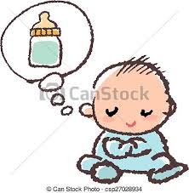
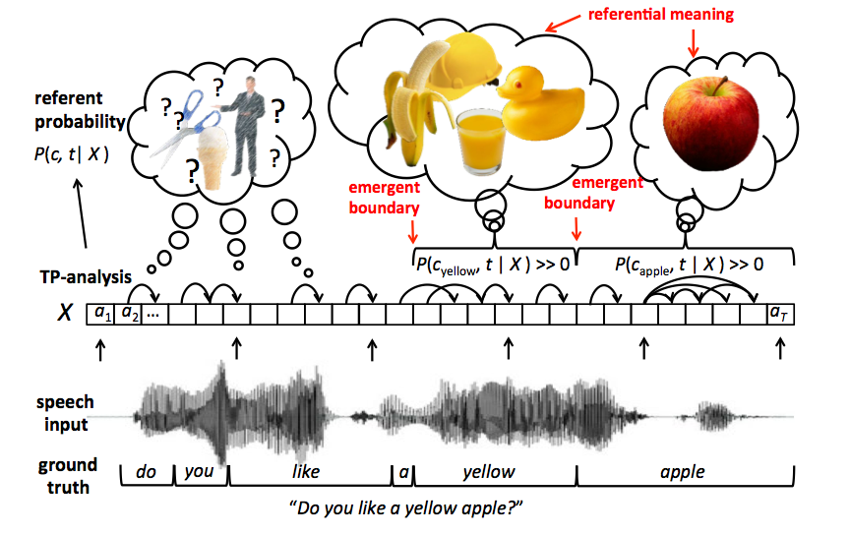
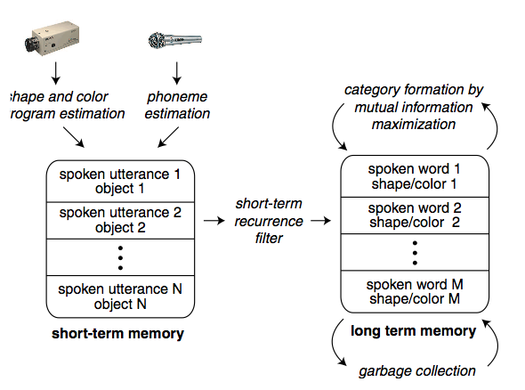
word learning
Cross situational learning
learning the correspondance between words and meaning across many examples
Roy & Pentland, 2002
Rasanen & Rasilo, 2005

Slide 52
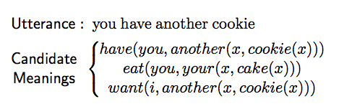


learning sentence parsing
see also Siskind 1996
Kwiatkowski et al 2012

Slide 53

Where do conceptual representations come from?
Cross-modal context
→ pragmatic use of language induce correlations between context and content
Descriptive/Referential
people talk about the here and now
infants: cross-situational learning (Yu & Smith, 2007)
computers: (Roy & Pentland, 2002, Boves, Ten Bosch, & Moore, 2007, Siskind, 1996, Harwath & Glass, 2015,2016,2017; Chrupala et al. 2017; Alishahi et al, 2017, etc)
b. Imperatives
people use language to program each other
infants: (Schaffer, H. R., & Crook, 1980; Rheingold, et al, 1987, etc)
adults (Tsividis et al 2017)
robots (Saponaro et al 2017); videogames (Kaplan et al 2017)
c. Questions/Answers
people use language to exchange information
infants: Jusczyk, et al (2003), etc
computers: (Liang et al. 2011; Sontoro et al 2017, … )
Vision
visual
concepts
semantic embeddings
word units
(lang model)
subword units
(acoustic model)
speech features
Notes:
questions:

Slide 54
Developmental Artificial Intelligence
language learning=learning a compact representation for the input (Kelley, 1967, de Marcken, 1996)
language learning=learning to translate between surface input to underlying concepts (Siklossy, 1968; Siskind, 1996)
language learning=learning to communicate (Bruner 1975)

Slide 55

language as a social ability
Grounded communication
language emerges as a communication protocol to help solving a particular task

Slide 56
Learning language with impoverished input: ‘creoles’
‘pidgins’: emerge in adult communities from different language backgrounds
inconsistent word order, no prefix/suffix, no tense marking; only one proposition at a time,
no consistent way of indicating who did what to whom
‘creoles’: emerge among infants who are immersed in pidgins (eg;hawaian creole)
emergence of grammatical words (auxiliaries, case marking, relative pronouns, etc)

Slide 57

Language creation with zero input: Nicaraguan Sign Language
In 1978, Nicaraguan governement opens the first public school for deaf children. The children did not have a sing language, but had develop some element of ‘home signs’ in their homes
Example English home signer:
http://goldin-meadow-lab.uchicago.edu/Images/shovel.mov
Notes:
57

Slide 58



At school, during the breaks, they develop a new sign language
(very different from signed Spanish)
http://www.pbs.org/wgbh/evolution/library/07/2/l_072_04.html

Slide 59

Inflection:
He likes me.
(as opposed to “he like me”)
effet d’age et de génération
Senghas & Coppola 2001
Notes:
59

Slide 60



language emergence in machines
Mordatch & Abbeel 2017
Talking heads (Steels et al 2001)
see also Foerster et al., 2016; Sukhbaatar et al., 2016; Lazaridou et al., 2016; Havrilov & Titov, 2017

Slide 61
Summing up
power law everywhere
the head of the distribution is easy (lots of data, interpolation)
the tail of the distribution is hard (scarce data, extrapolation)
humans deal with the problem though a host of mechanisms
domain adaptation (new conditions, domains)
episodic memory (new words)
rule systems (new combinations)
unsupervised/weakly supervised learning (small, noisy data)
mimicking these with machine learning an active & exciting area of research

Slide 62
Standard Machine Learning
human supervision:
strong (unambiguous)
dense (high bitrate)
mono directional
labels
cost function
(evaluation & training)
human
expert
optimization algorithm
data (big)

Slide 63
Standard Machine Learning
Human-like Machine Learning
human supervision:
strong (unambiguous)
dense (high bitrate)
mono directional
human supervision:
weak (ambiguous)
sparse (low bitrate)
bi-directional
labels
cost function
cost function
feedback
(evaluation & training)
human
expert
optimization algorithm
naïve human
optimization algorithm
data (big)
naturalistic data (bigger, messier, multimodal)

